Slide 1
CHAPTER 3 Inheritance
Er. Ganga Gautam

Slide 2
OUTLINES:
Introduction to Inheritance
Inheritance Relationship Diagram
Inheritance Mode: Public, Private & Protected
Types of Inheritance: Single, Multilevel, Hierarchical, Multiple and Hybrid
Ambiguity Resolution
Multipath Inheritance and Virtual Base Class
Constructor and Destructor in Derived Class
Subclass, Subtype and Principle of Substitutability
Composition and its Implementation
Composition Relationship Diagram
Software Reusability

Slide 3
Inheritance
Inheritance refers to the sharing and transforming the properties of one class to another class in a secured manner.
So, it is the process by which new classes called child class (or sub class or derived class) are created from existing class called Parent class (or base class).
The derived class has some or all the features of the base class.

Slide 4
Base class and Derived class
The existing class from which another class is derived is known as the base class,
and the newly created class is called its derived class.
The derived class can inherit all or some properties Base class.
Base class aka super/parent class
Derived class aka child/sub class
Base Class
Child Class

Slide 5
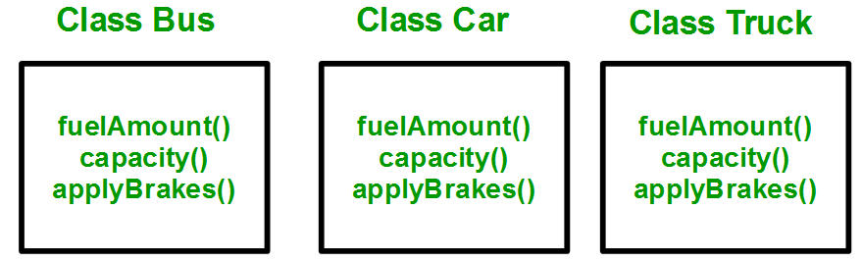
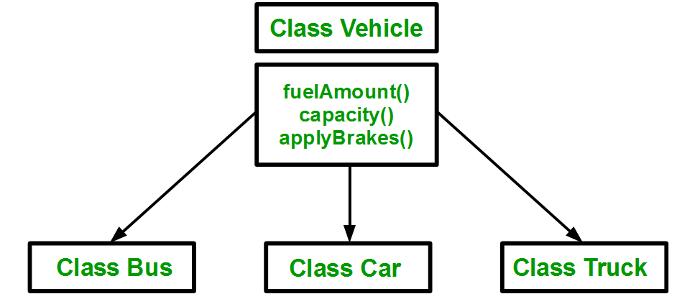
Why need of inheritance?
Solution:
Create a Base class
Encapsulate all the functions in that class.
Create three child class
Problems:
Three separate classes
Functions() repeated for all classes
Longer code

Slide 6
Implementing inheritance in C++
Syntax:
class subclass_name : visibility_mode base_class_name
{
//body of subclass
};
Where:
subclass_name is the name of the sub class,
visibility_mode may be either Private or Public or Protected. base_class_name is the parent class
The colon (:) indicates that the sub-class is derived from the base-class.
Eg:
Class Box: public Shape
{
…..
}

Slide 7
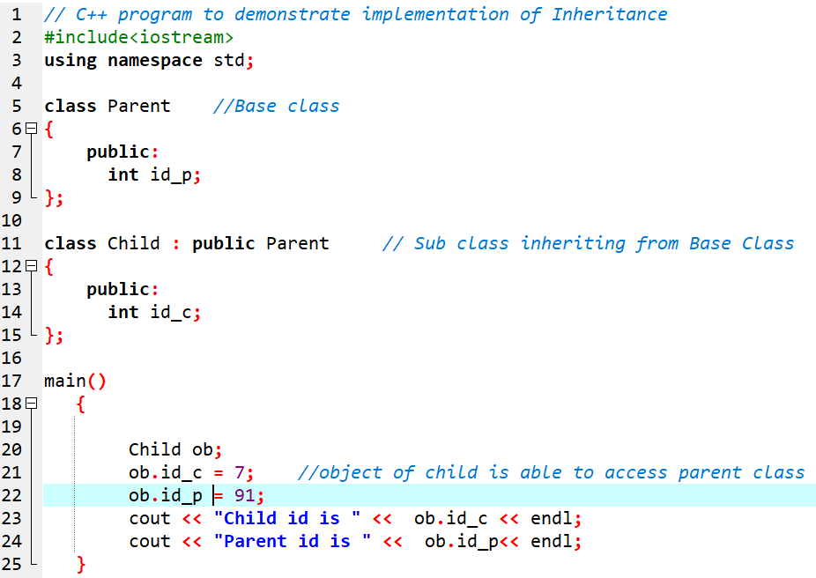
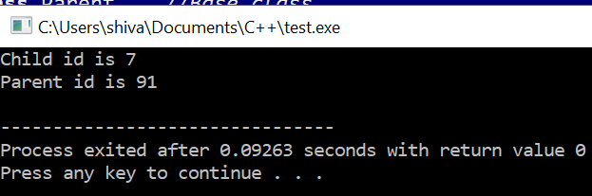
Sample program

Slide 8
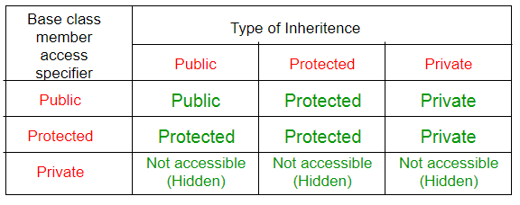
4.3 Visibility mode in inheritance
1. Private mode
When a base class is inherited in private mode, protected and public members of base class become private members for the derived class.
And they cannot be accessed outside the derived class.
The private members of base class are not inherited.
2. Protected mode
When a base class is inherited in protected mode, protected and public members of base class become protected members for the derived class.
The private members of base class are not inherited.
3. Public mode
When a base class is inherited in public mode, public members of base class remains public and protected members also remains protected members for the derived class
The private members of base class are not inherited.

Slide 9
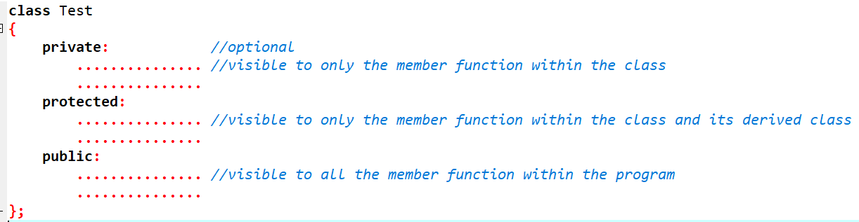
4.4 Making private members inheritable
No any other option.
Just need to make private members as public members

Slide 10
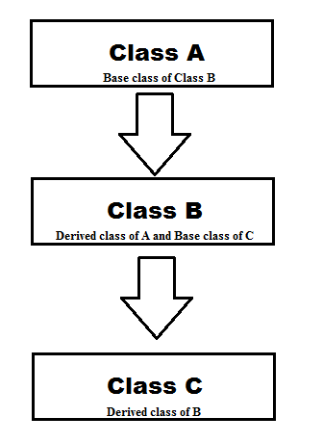
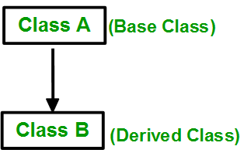
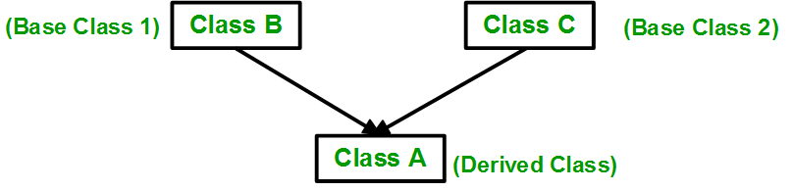
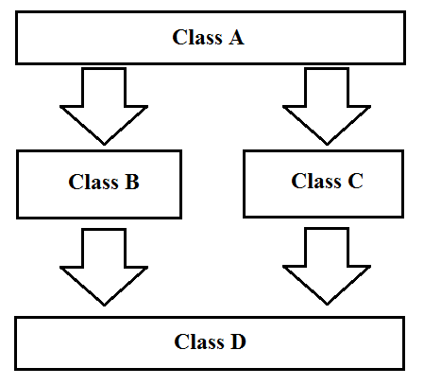
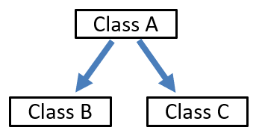
4.5 Types of inheritance
ii) Multilevel Inheritance
i) Single Inheritance
iii) Multiple Inheritance
v) Hybrid Inheritance
iv) Hierarchical Inheritance

Slide 11
i) Single Inheritance
In single inheritance, a class is allowed to inherit from only one class. i.e. one sub class is inherited by one base class only.
It is the foundation for all types of inheritance.
General form:
class subclass_name : access_mode base_class
{
//body of subclass
};
Eg:
Class Box: public Shape
{
….
};

Slide 12
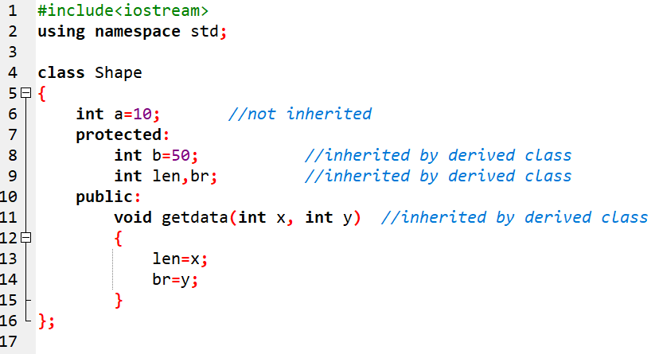
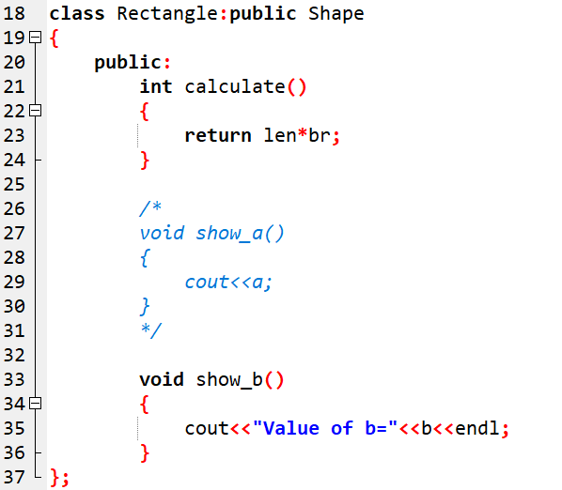
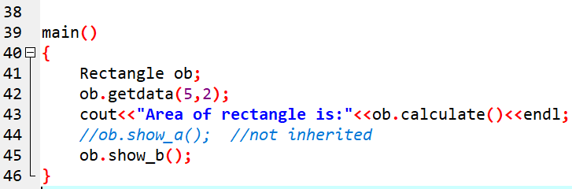
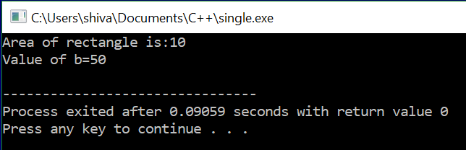
i) Single Inheritance : Sample program
Shape
{
Private: a=10
Protected: b, len, br
Public: getdata()
}
Rectangle
{
Public: calculate() show_b()
}

Slide 13
ii) Multilevel Inheritance
In this type of inheritance, a derived class is created from another derived class.
General Form:
class B : access_mode A
{
//body of subclass B
};
class C: access_mode B
{
//body of subclass C
};
Eg:
Class Box: public Shape
{
…..
};
Class Triangle: public Box
{
…….
};

Slide 14
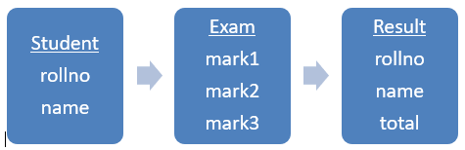
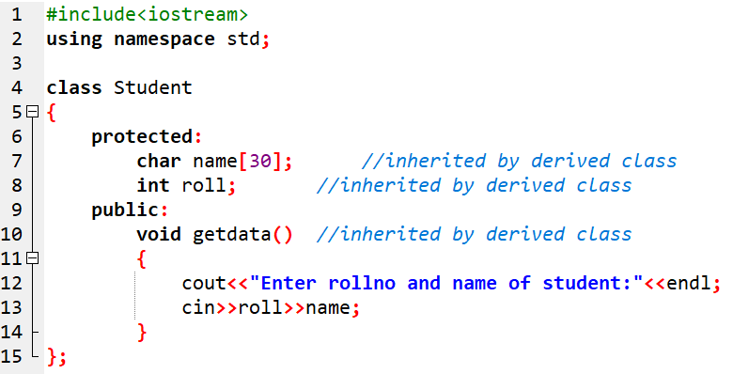
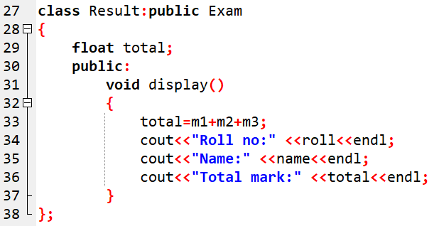
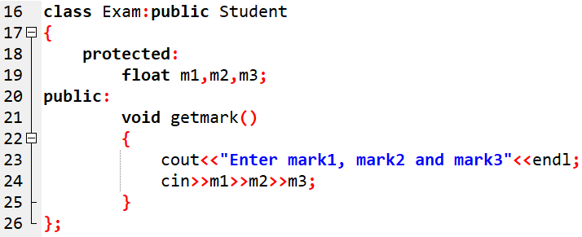
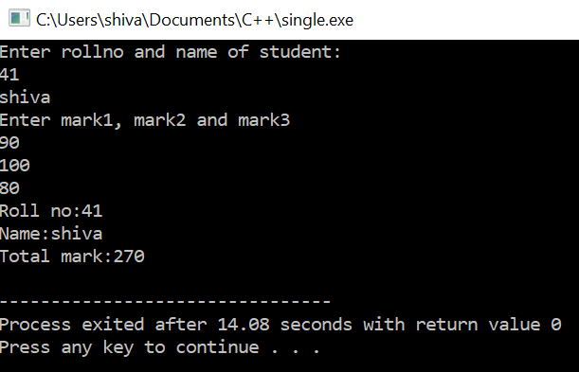
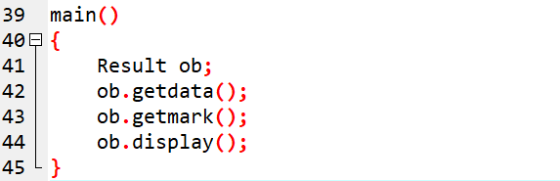
ii) Multilevel Inheritance : Sample program

Slide 15
iiI) Multiple Inheritance
Multiple Inheritance is a feature of C++ where a class can inherit from more than one classes i.e. one sub class is inherited from more than one base classes.
Syntax:
class subclassName : accessMode baseclass1, accessMode baseclass2, ....
{
//body of subclass
};
Here, the number of base classes will be separated by a comma (,) and access mode for every base class must be specified.

Slide 16
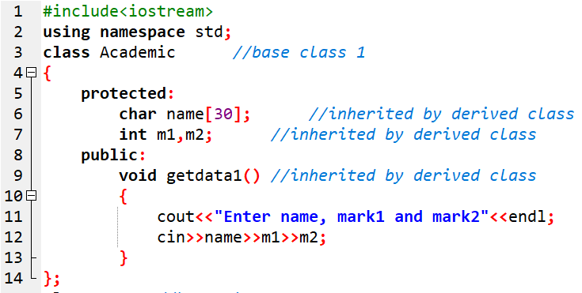
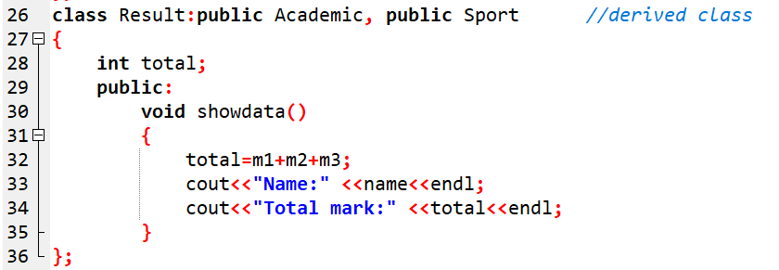
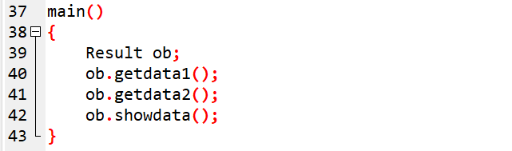
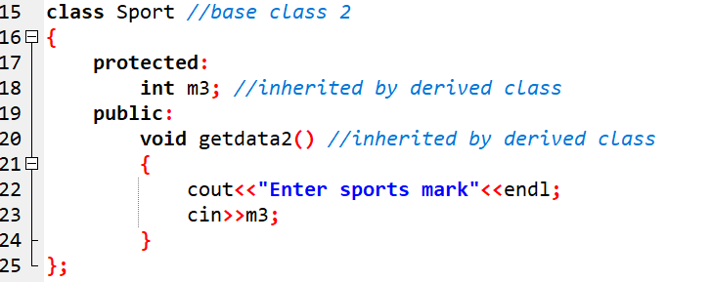
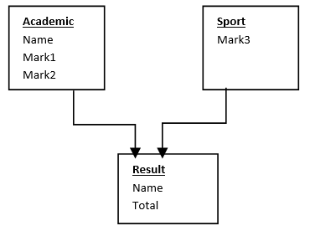
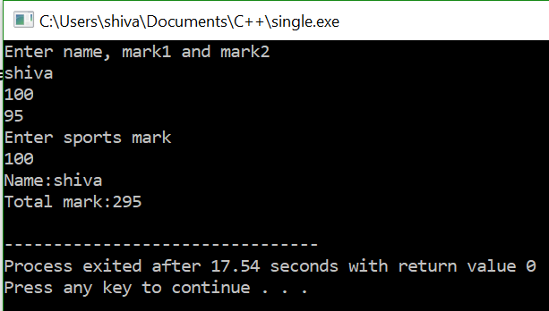
iiI) Multiple Inheritance : Sample Program

Slide 17
iv) Hierarchical Inheritance
In this type of inheritance, more than one sub class is inherited from a single base class. i.e. more than one derived class is created from a single base class.

Slide 18
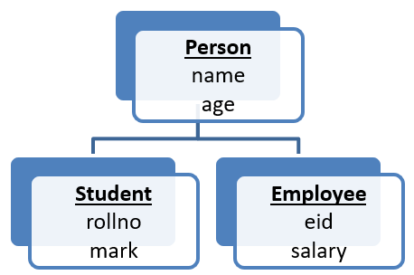
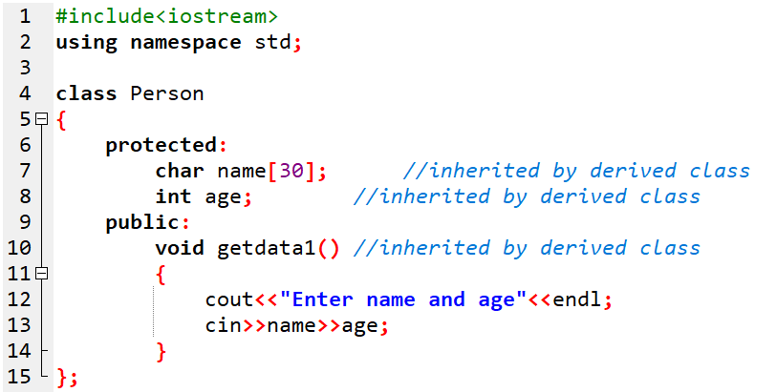
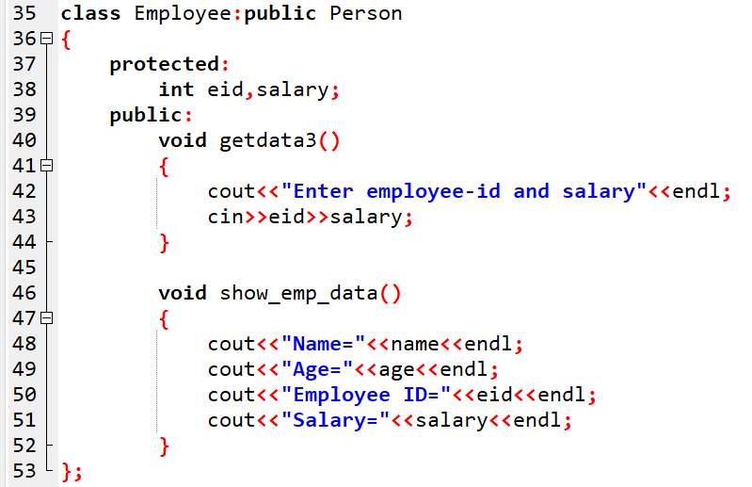
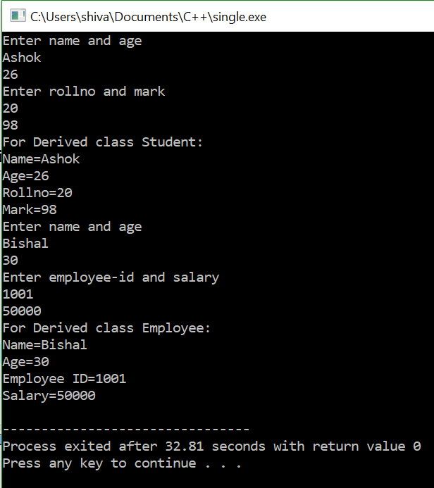
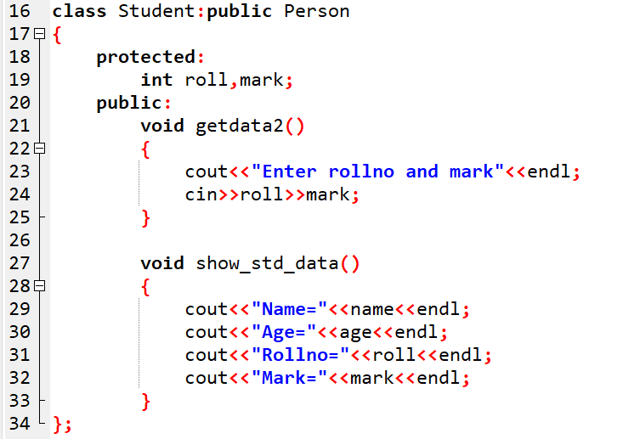
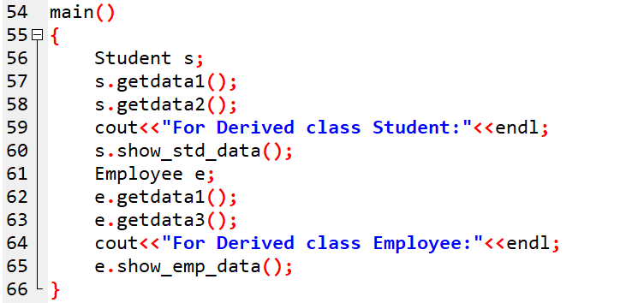
iv) Hierarchical Inheritance : Sample program

Slide 19
v) Hybrid Inheritance
Combination of different types of inheritance is known as Hybrid Inheritance.
Hybrid Inheritance is implemented by combining more than one type of inheritance.
For example: Combining Hierarchical inheritance and Multiple Inheritance.

Slide 20
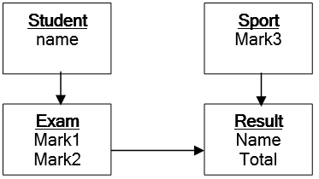
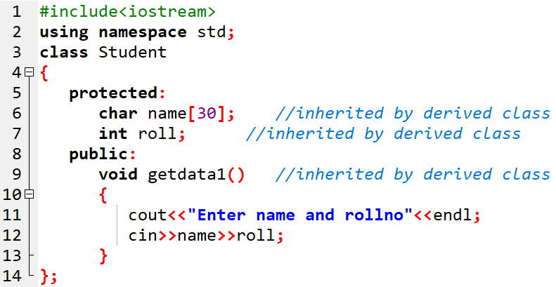
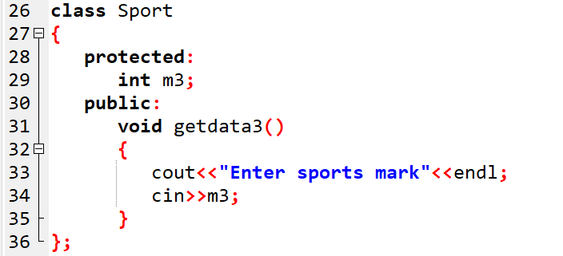
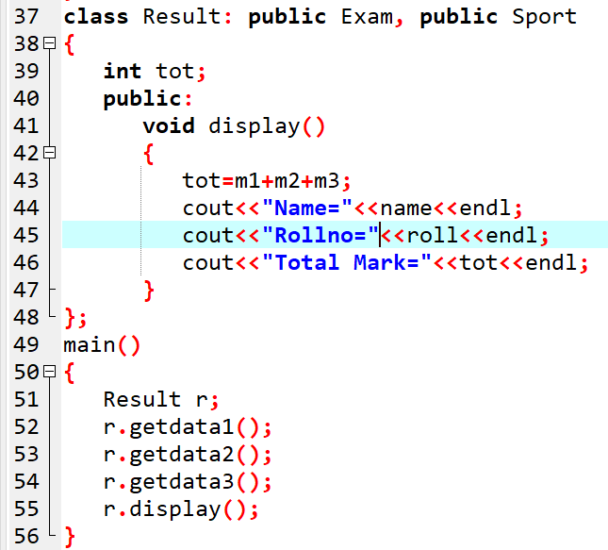
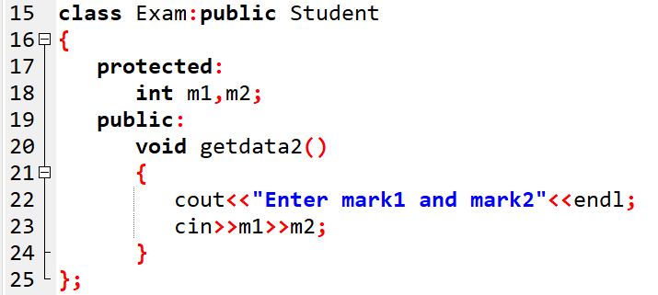
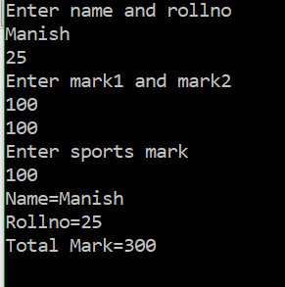
v) Hybrid Inheritance : Sample program

Slide 21
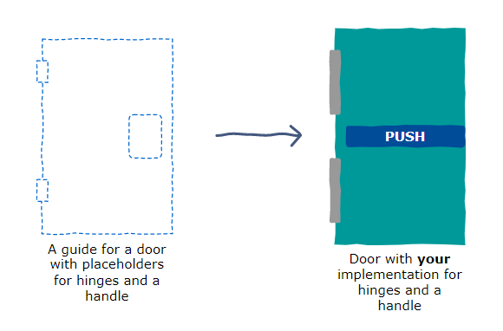
4.6 Abstract Base Class
If we were to build a simple door, we would need a guide to follow.
This guide may require us to include a handle and a hinge.
The advantage of having this guide is that it helps us to not forget to include these two features in our implementation.
This is how we should think about an Abstract Base Class (ABC).

Slide 22
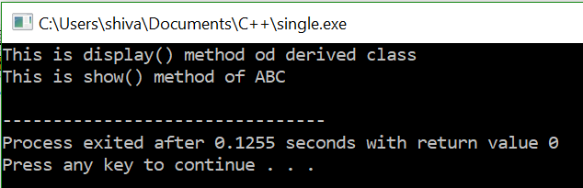
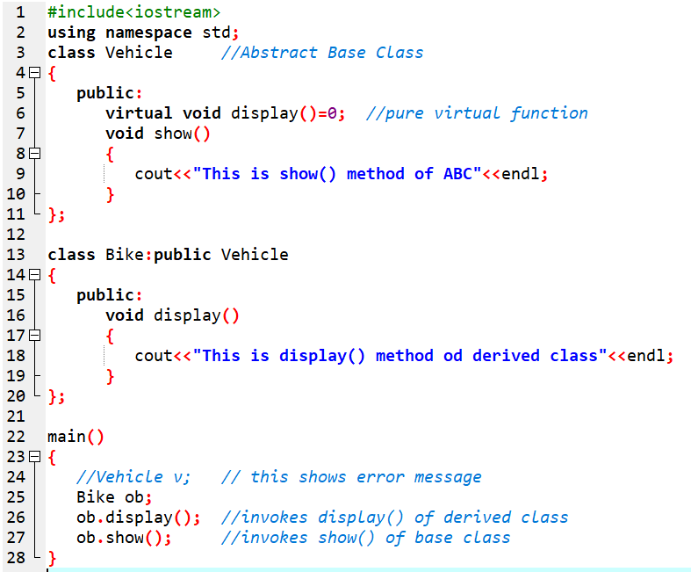
4.6 Abstract Base Class
An Abstract Base Class (ABC) is a class that is designed to be specifically used as a base class. It is not used to create objects.
Allows base class to provide only an interface for the derived classes.
Prevents anyone from creating an instance of this class. No object of an ABC can be created.
A class is made abstract by defining at least one virtual function pure. A pure virtual function is one with an initialize of =0 on its declaration as:
virtual returntype functionname()=0;
General form Abstract class is;
class Baseclassname
{
public:
//pure virtual function
};

Slide 23
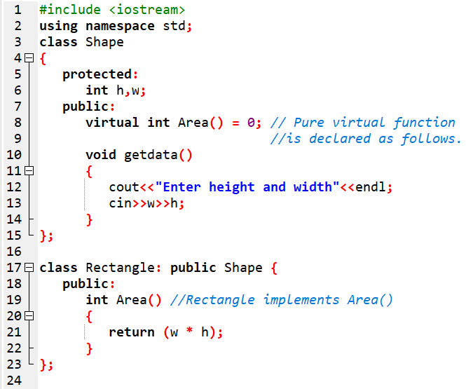
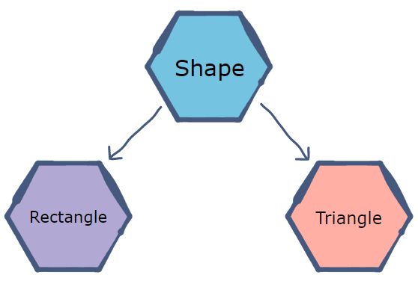
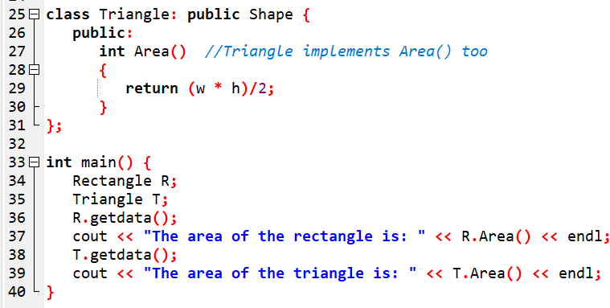
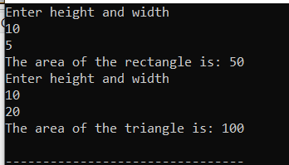
4.6 Abstract Base Class : Sample program

Slide 24
4.7 Ambiguity in inheritance
The ambiguity is the situation in which the main() function (or the calling function) cannot give decision to call the function.
If the base class and derived class have the same function name, then this creates ambiguity.
The compiler cannot decide which function to call.
There are few cases where ambiguity occurs:
i) Ambiguity due to function overriding
ii) Ambiguity in multiple inheritance
iii) Ambiguity in multipath inheritance

Slide 25
i) Ambiguity due to function overriding
This type of ambiguity occurs when there are same function names in the base as well as in its derived classes.
The compiler cannot decide which function to call.
So, ambiguity occurs due to the function overriding.

Slide 26
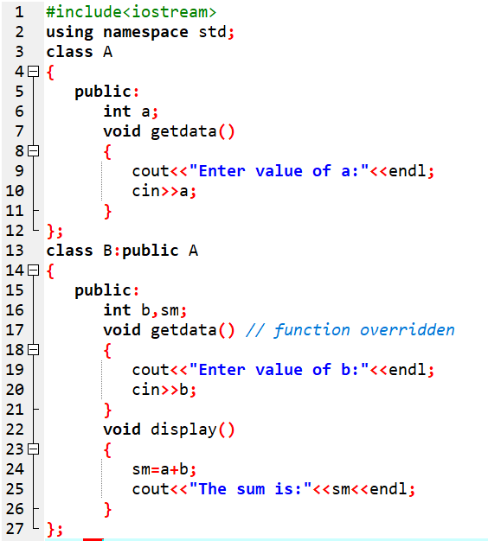
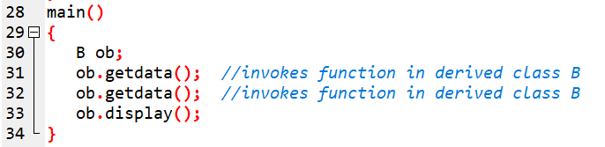
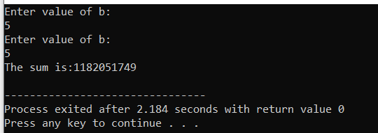
i) Ambiguity due to function overriding: Sample Program
Here, the compiler is confused which function getdata() to call.
To resolve this ambiguity, we can use scope resolution operator (::) in the main function while calling them.

Slide 27
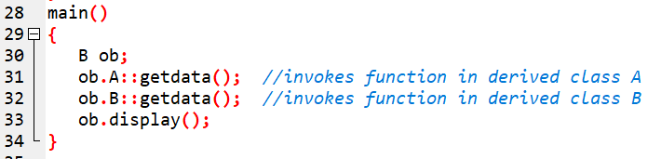

i) Ambiguity due to function overriding: Resolved
Thus, ambiguity is resolved

Slide 28

ii) Ambiguity in Multiple inheritance
In multiple inheritance, two base class may have functions with same name.
If the object of the derived class needs to access one of them, the compiler is confused which one to invoke.
This is ambiguity in multiple inheritance.
This can be resolved by using scope resolution operator while invoking.
The syntax is:
Objectname.classname::functionname();
Eg:
ob.A::getdata();

Slide 29


ii) Ambiguity in Multiple inheritance: Sample Program
To resolve this, we use scope resolution operator while invoking.

Slide 30


ii) Ambiguity in Multiple inheritance: Resolved

Slide 31



iii) Ambiguity in Multipath inheritance
Such ambiguity occurs when a derived class have two base classes and these two base classes again have one common super-base class.
In such case, the compiler is confused which path to follow while inheriting the state and behavior of the super-base class.
So, grand-child class inherits the properties of class grand-parent class for twice.
This case can be resolved by using the concept of “Virtual Base class”.
General form is:
After resolving,

Slide 32



iii) Ambiguity in Multipath inheritance: Resolved

Slide 33


4.8 Virtual Base class
In the diagram, all the Public and Protected members of Grand-parent are inherited in the child twice:
first via Parent1 and second via Parent2.
This means child would have duplicate set of members inherited from Grand-parent.
This introduces ambiguity(duplication) and should be avoided.
The duplication of inherited members due to their multipaths can be avoided by making common base class as virtual class.
Such class is called Virtual Base Class.
This helps us to inherit directly as shown in the broken line.

Slide 34

4.8 Virtual Base class : Sample Program
WAP to implement the below inheritance and resolve the ambiguity if it occurs.

Slide 35






4.8 Virtual Base class : Sample Program

Slide 36
4.9. Merits and Demerits of Inheritance
Merits | Demerits
Reusability | Execution speed
Code sharing | Program size
Consistency of interface | Program complexity
Construction of software components
Rapid prototyping
Information hiding

Slide 37
4.10. Constructors and Destructors in Derived class
If the base class contains a zero-argumented constructor or no constructor, then the derived class does not require a constructor,
But if the base class contains a parameterized constructor, then it is essential for the derived class to have a constructor.
How invoked?
Firstly, the constructor in the Base class is executed and then that of the Derived class.
The derived class constructor passes arguments to the base class constructor.
Destructors are executed in reverse order of constructor execution.
The destructor in the derived class is executed first and then that of the base class.

Slide 38
4.10. Constructors and Destructors in Derived class
Syntax for Derived class constructor
Constructor(parameters): Base class(parameters)
Eg:
Rectangle( int j): Polygon(j)

Slide 39


Sample program 1: Case 1 (derived class constructor not required )
WAP to show that derived class constructor is not required if the base class has no arguments in its constructor.

Slide 40




Sample program 2: Case 2 (derived class constructor required )
WAP to show that derived class constructor is required if the base class has arguments in its constructor.

Slide 41



Sample program 3: Case 2 (derived class constructor required )
WAP to show that derived class constructor is required if the base class has arguments in its constructor.

Slide 42



Sample program 4: Case 2 (derived class constructor required )
WAP to show that derived class constructor is required if the base class has arguments in its constructor.

Slide 43

4.11. IS-A rule and HAS-A rule
Two ways of code reuse:
Inheritance (IS-A rule)
Maruti is a car.
Composition (HAS-A rule)
Maruti has engine

Slide 44


IS-A rule
As shown above, Car class has a couple of instance variable and few methods. Maruti is a specific type of Car which inherits Car class means Maruti IS-A Car.

Slide 45


HAS-A rule
Maruti class uses Car object’s getInfo() method via composition. We can say that Maruti class HAS-A color and maxSpeed.

Slide 46
4.12 Composition
In composition, we simply create objects of our existing class inside a new class.
And this is called composition because the new class is composed of objects of existing classes.
This technique of including user defined object as a part of newly defined object is called composition.

Slide 47




4.12 Composition : Sample Program 1

Slide 48





4.12 Composition : Sample Program 2

Slide 49
4.14 Principle of substitutability
Substitutability means the feature of a program in which certain things can be substituted in other section or part of a program without changing the effect.
Principle of Substitutability states that:
In a computer program, if B is a subtype of A, then objects of type A may be replaced with objects of type B without altering any of the desirable properties of the program. It means an object of type A may be substituted with any object of a subtype B.

Slide 50
Sub-class
Subclass refers to the class which is derived from its parent class. Such as:
Class A
{
……………………..
};
Class B : public A
{
……………………….
};
Here, class B is a subclass of class A.
However, it does not follow the principle of substitutability.
Simply, the base class cannot be replaced by its subclass.
Here, class B specializes class A to a particular use, by reusing some of its behavior and perhaps overriding parts.
a subclass is a class that inherits from a superclass and extends or modifies its behavior.

Slide 51
Sub-type
Subtype refers to the class which follows Liskov’s substitution principle.
These types of subtypes can replace the parent class without making any errors.
A subtype inherits all features from its supertypes.
Class A
{
……………………..
};
Class B : public A
{
……………………….
};
Here, Subtyping means writing a class B which conforms to A’s interface, as well as possibly adding some new methods of its own.
As per Liskov,s substitution principle, we can supply B in any context where an A is expected.
a subtype is a type that is derived from a supertype and can be substituted for the supertype.

Slide 52
Software Reusability
Software reusability refers to the ability to reuse existing code components in new applications.
Object-Oriented Programming (OOP) provides powerful mechanisms to enhance software reusability.
By embracing tools for achieving software reusability, developers can save time, improve code quality, and enhance maintainability

Slide 53
key concepts and techniques for achieving software reusability in OOP:
Encapsulation
Inheritance
Polymorphism
Design Patterns
Libraries and Frameworks

Slide 54
Benefits of Software Reusability:
Saves development time and effort: Reusing existing code reduces the need for reinventing the wheel.
Improves code quality: Reusable components are often thoroughly tested and debugged, leading to more reliable code.
Enhances maintainability: Changes made to reusable components propagate across multiple applications, ensuring consistency and ease of maintenance.

Slide 55
End of chapter 3

